Slide 1
Road Map for 2026-27
Dr S R Sundararajan

Slide 2

Enrich knowledge, skill and Empower all
Presidential Theme

Slide 3
1 Post graduate Training
Exposures of surgical training is not same
No uniform curriculum regarding surgical training
Cadaver Training Exposure

Slide 4
Cadaveric skill Training (CAST)
Upperlimb cadaver course
Lowerlimb cadaver course
Pelvis course

Slide 5
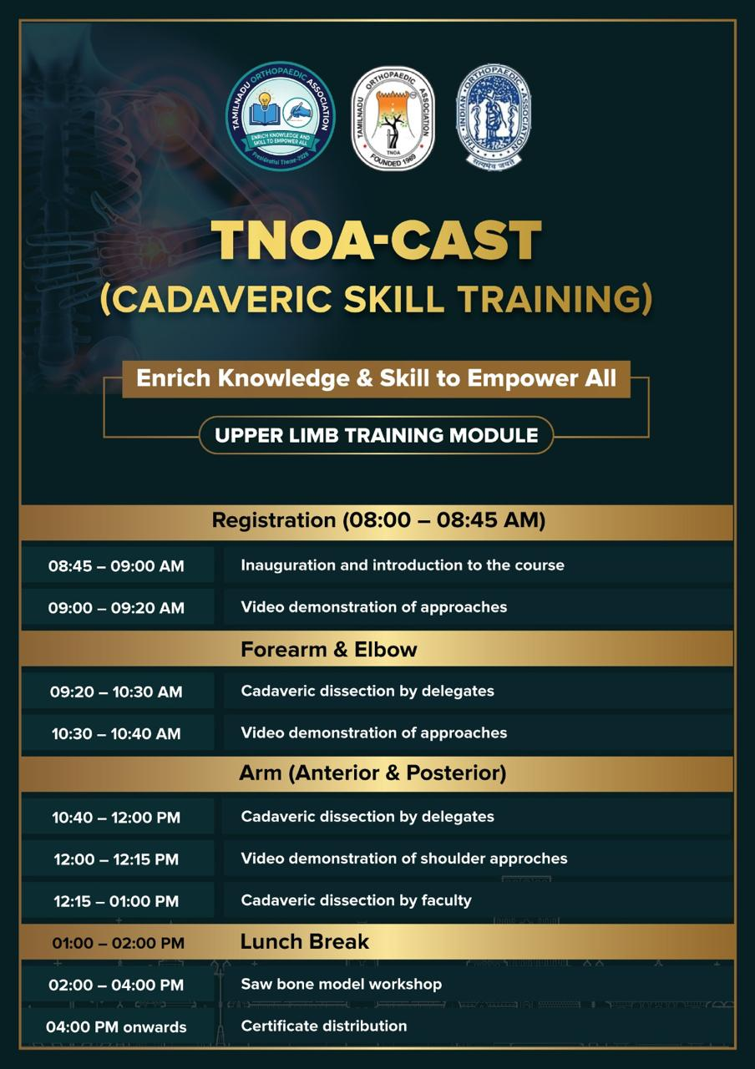

Slide 6
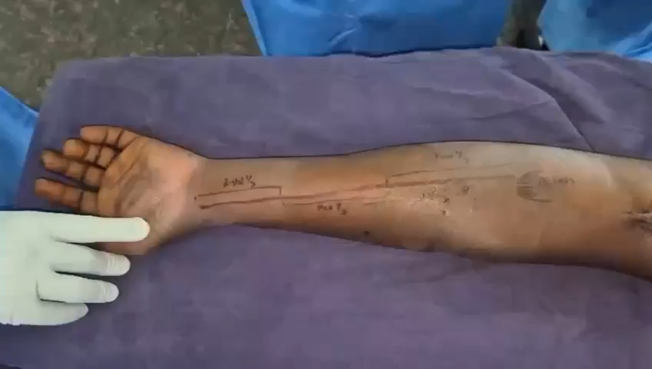
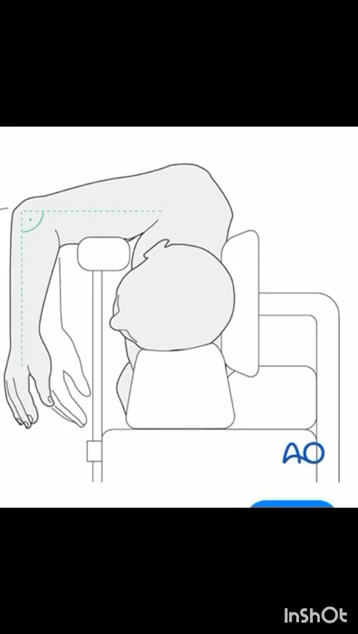
Dr Devendra
Dr Velmurugesan

Slide 7
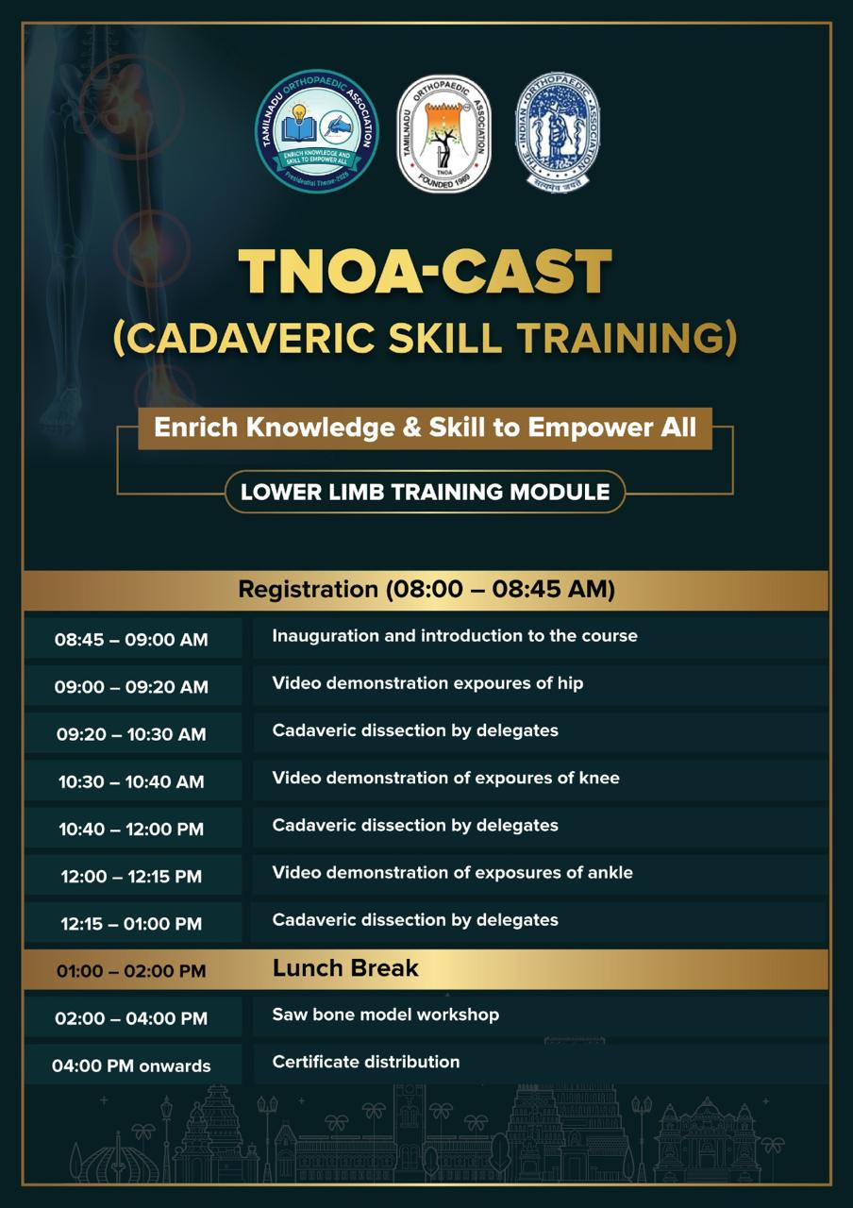

Slide 8
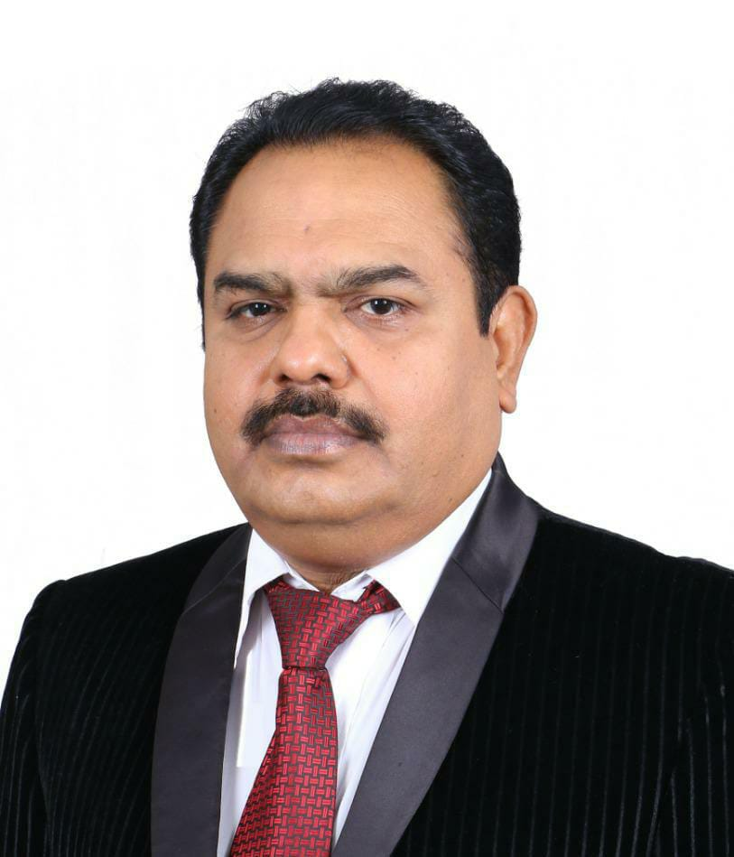
First course in Tirunelveli Medical college-March 21
Course coordinator
Prof Manikandan. HOD
Dr Marimuthu
Dr Dhamodharan
DR Alfred

Slide 9
April 11 th SRM Medical college
Coordinator Prof VijayAnand HOD
May 2 nd-Cuddalore Medical college
Coordinator-Prof Senthilnathan HOD

Slide 10
June 13 th-Madurai Medical college
Cordinators
Dr Pathiarasakumar HOD
Dr K P Saravankumar

Slide 11
July 4th –Ramachandra Medical college
Coordinator-Dr Suresh Perumal
Auguest 1st -Tiruchi Medical college
Coordinator-Prof Kalyanasundaram HOD
December 5 th -Salem Medical college
Coordinator-Prof Parthasarathi

Slide 12
2-Joint Preservation Programme
Fastest growing subspeciality
IAS –close to 5000 members
TNAS
Great opportunity for youngsters

Slide 13
Knee
ACL
Meniscus
Cartilage
Osteotomy

Slide 15
1 ST Programme-Tirunelveli
March 22
Coordinator-Prof Manikandan HOD and Dr INIGO

Slide 16
April 12 th –Chennai, Chengalpattu
June 14 th –Madurai
AUGEST – 2 nd - Trichy
December6th- -Salem

Slide 17
3 –Foot and Ankle
Techniques in Foot and Ankle-chapters
Compiled for Text book
Coordinators
Dr Ramakanth
Dr Terrance Dsouza

Slide 18

4 Sports Injury Prevention Programme
3 hours Programme
Injury Prevention, Nutrition and Anti Doping
Excellent speakers will be arranged
Need Local coordinators
Can be done in any town or city
Target-All local sports club

Slide 19
5 SPORTS DAY
August 14 th and 15th
Dindugal

Slide 20
Thank you

